Slide 1
DMA Controller

Slide 2
DMA
DMA Definitions:
DMA occurs between an I/O device and memory without the use of the microprocessor
DMA read transfer data from the memory to I/O device
DMA write transfer data from the I/O to memory
MRDC & IOWC signals to simultaneously activate for read DMA

Slide 3
Basic DMA operation
The direct memory access (DMA) I/O technique provides direct access to the memory while the microprocessor is temporarily disabled.
A DMA controller temporarily borrows the address bus, data bus, and control bus from the microprocessor and transfers the data bytes directly between an I/O port and a series of memory locations.
The DMA transfer is also used to do high-speed memory-to memory transfers.
Two control signals are used to request and acknowledge a DMA transfer in the microprocessor-based system.

Slide 4
The HOLD signal is a bus request signal which asks the microprocessor to release control of the buses after the current bus cycle.
The HLDA signal is a bus grant signal which indicates that the microprocessor has indeed released control of its buses by placing the buses at their high-impedance states.
The HOLD input has a higher priority than the INTR or NMI interrupt inputs.

Slide 5
The 8237 DMA controller
The 8237 DMA controller supplies the memory and I/O with control signals and memory address information during the DMA transfer.
The 8237 is capable of DMA transfers at rates of up to 1.6M bytes per second.
Each channel is capable of addressing a full 64K-byte section of memory and can transfer up to 64K bytes with a single programming.

Slide 6
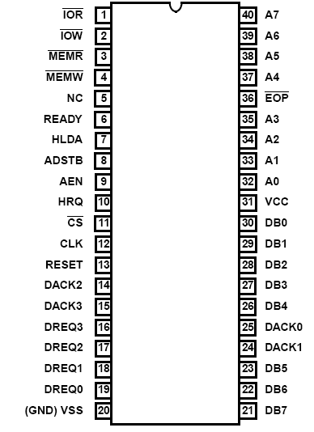
8237 pins
CLK: System clock
CS΄: Chip select (decoder output)‏
RESET: Clears registers, sets mask register
READY: 0 for inserting wait states
HLDA: Signals that the μp has relinquished buses
DREQ3 – DREQ0: DMA request input for each channel
DB7-DB0: Data bus pins
IOR΄: Bidirectional pin used during programming
and during a DMA write cycle
IOW΄: Bidirectional pin used during programming
and during a DMA read cycle
EOP΄: End of process is a bidirectional signal used as input to terminate a DMA process or as output to signal the end of the DMA transfer
A3-A0: Address pins for selecting internal registers
A7-A4: Outputs that provide part of the DMA transfer address
HRQ: DMA request output
DACK3-DACK0: DMA acknowledge for each channel.
AEN: Address enable signal
ADSTB: Address strobe
MEMR΄: Memory read output used in DMA read cycle
MEMW΄: Memory write output used in DMA write cycle
ACOE255
Microprocessors I - Frederick University

Slide 7
A DMA controller is capable of becoming the bus master and supervising a transfer between an I/O or mass storage interface and memory.
While making a transfer, it must be able to place memory addresses on the bus and send and receive handshaking signals in a manner similar to that of the bus control logic.
The purpose of a DMA controller is to perform a sequence of transfers (i.e., a block transfer) by stealing bus cycles.
A DMA controller is designed to service one or more I/O or mass storage interfaces, and each interface is connected to the controller by a set of conductors.
A portion of a DMA controller for servicing a single interface is called a channel.

Slide 8
The general organization of a one-channel DMA controller and its principal connections is shown in Fig. 9-36.
In addition to the usual control and status registers, each channel must contain an address register and a byte (or word) count register.
Initializing the controller consists of filling these registers with the begin­ning (or ending) address of the memory array that is to be used as a buffer and the number of bytes (words) to be transferred.
For an input to memory, each time the interface has data to transfer it makes a DMA request. The controller then makes a bus request and, when it receives a bus grant, it puts the contents of the address register on the address bus, sends an acknowledgment back to the interface,

Slide 9
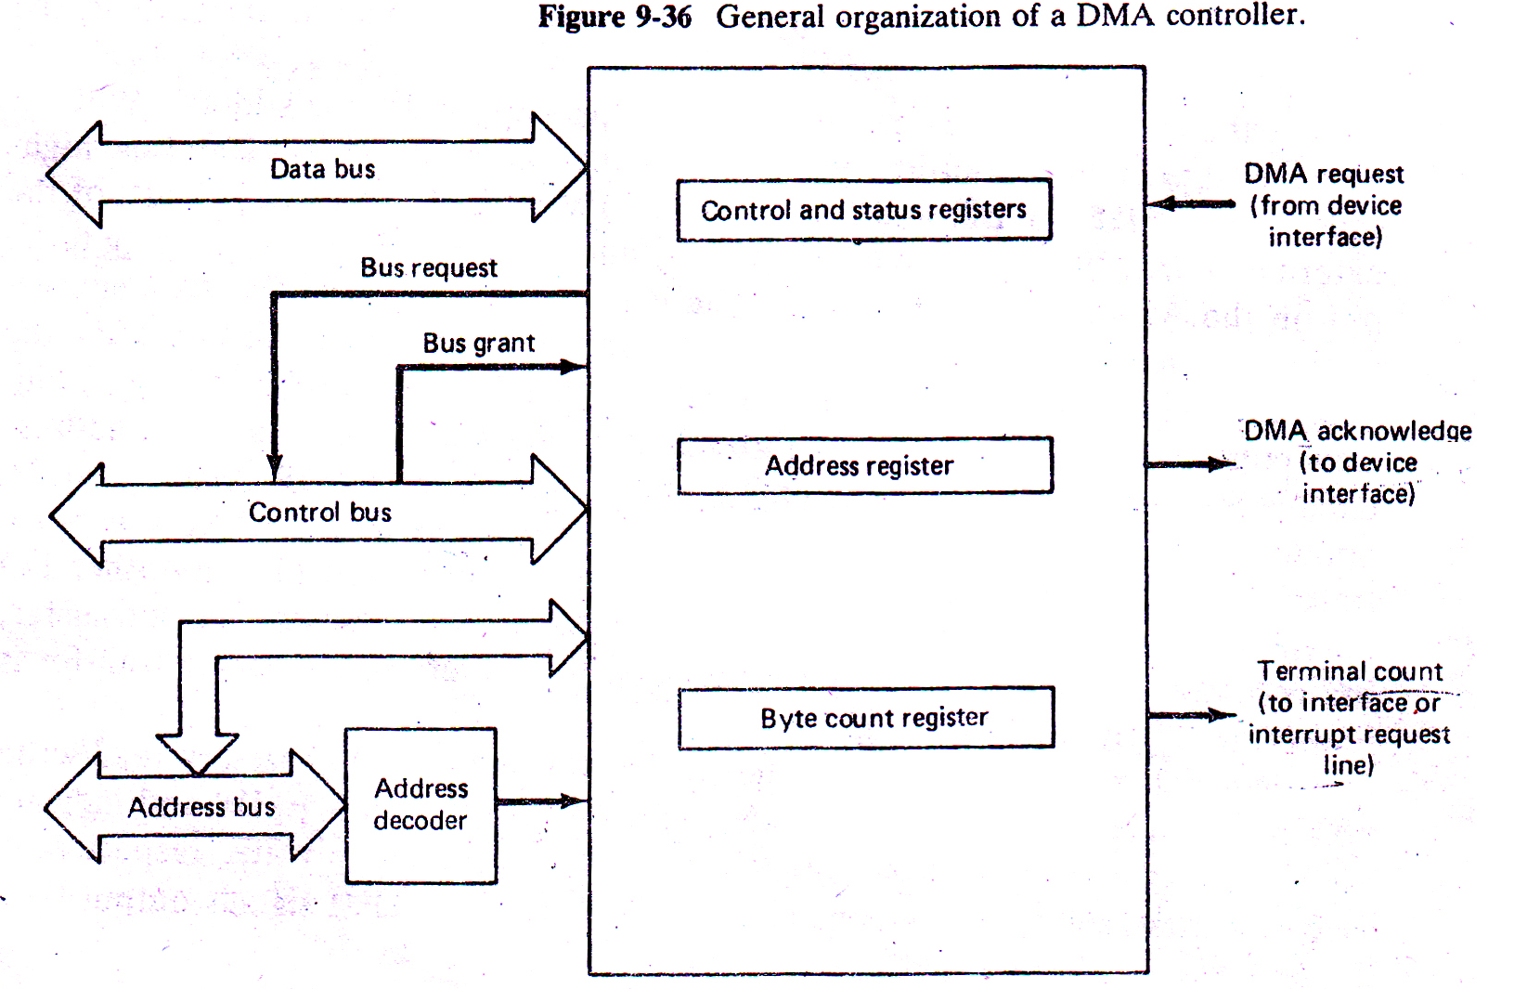

Slide 10
and issues I/O read and memory write signals.
The interface then puts the data on the data bus and drops its request. When the memory accepts the data it returns a ready signal to the controller, which then increments (or decrements) the address register, decrements the byte (word) count, and drops its bus request.
Upon the count reaching zero, the process stops and a signal is sent to the processor as an interrupt request or to the interface to notify it that the transfers have terminated. An output is similarly executed, except that the controller issues I/O write and memory read signals and the data are transferred in the other direction.

Slide 11
As an example, let us consider the Intel 8237 DMA Controller, whose overall organization alone with that of the associated logic needed an 8088 system is given in Fig. 9-37.

Slide 12
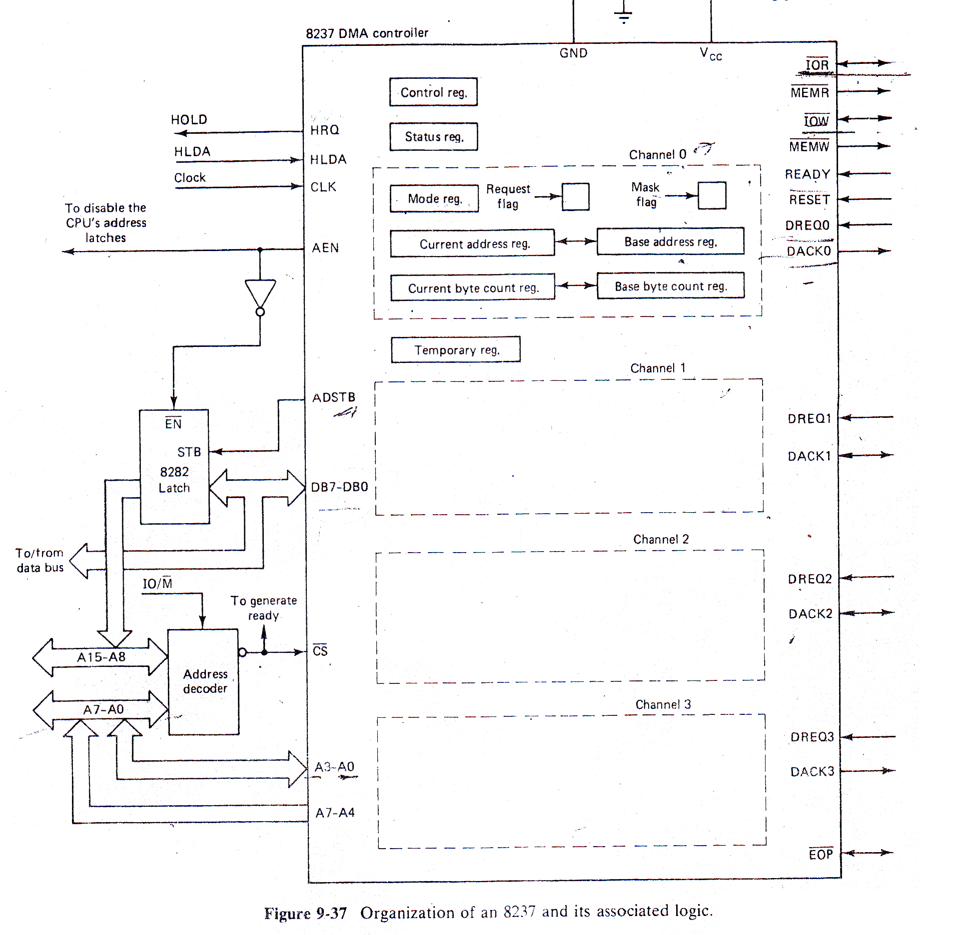

Slide 13
When data are being put in or taken out of the 8237’s registers, the 8237 is a slave it receivers 16-bit addresses with the 12 MSBs of those addresses determining whether or not the chip is selected and the 4 LBSs being used fro internal addressing.
When both HRQ and CS are low, the 8237 becomes a slave with the IOR and IOW being the input control pins. The CPU can read from or write to the internal registers of the controller by activating IOR or IOW.
The AEN, which is active when the controller is-a master and is outputting an address, is 0 while the system is communicating with the controller’s registers.

Slide 14
If the controller is the master, then it must supply the bus address. When it is master it puts the low-order byte of the address on the pins A7-A0 and the high­ order byte on DB7-DB0, and sets AEN to l.
With AEN = 1, the outputs of the external address latch are enabled, thereby allowing the upper address byte to be put on the A15-A8 lines.

Slide 15
The upper-4 bits of the address, A19-A16, cannot be obtained from the 8237, but must be programmed separately before the block transfer begins.

Slide 16
While it is master the controller must also output the necessary read/write commands.
These commands are IOR, MEMR, IOW and MEMW and indicate an I/O read, a memory read, an I/O write, respectively. Because these signals do not match the RD, WR, and IO/M signals output by a minimum mode-8086, a read/write encoding circuit such as the one shown in Fig. 9-39 is needed to perform the translation between the two sets of signals.
During a DMA transfer, the controller disables the outputs of the read/write encoder from the command lines by activating the AEN signal.

Slide 17
As with the processor timing, the READY signal is used to extend the bus cycles by inserting wait states when servicing slow devices. A RESET signal clears the control, status, and temporary registers and the request flags, and sets the mask flags.

Slide 18
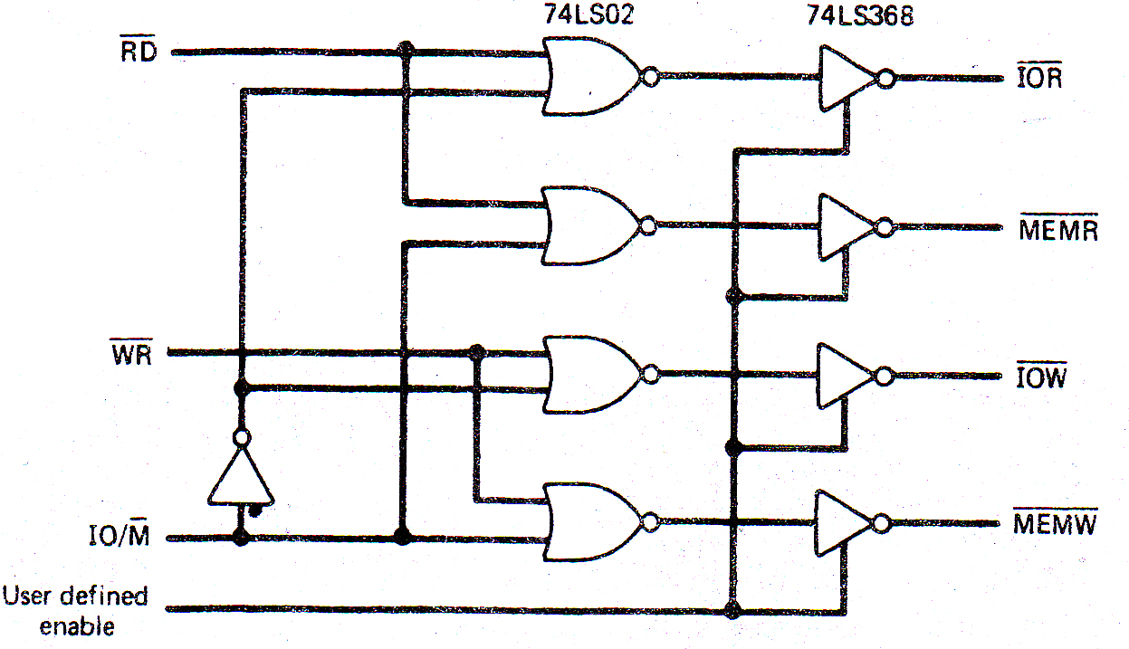

Slide 19
An 8237 includes control, status, and temporary registers, and four channels, each containing a mode register, current address register, base address register, current byte count register, base byte count register, request flag, and mask flag. Each channel may be put in one of four modes, with its current mode being determined by bits 7 and 6 of the charnel’s mode register­. The four­ possible modes are:
Single Transfer Mode (O1)- After each transfer the controller will release the bus to the processor for at least one bus cycle, but will immediately begin testing for DREQ inputs and proceed to steal another cycle as soon as a DREQ line becomes active.
Block Transfer Mode (10)-DREQ need only be active until DACK becomes active, after which the bus is not released until the entire block of data has been transferred.
further.

Slide 20
Demand Transfer Mode (00)---This mode is similar to the block mode except that DREQ is tested after each transfer. If DREQ is inactive, transfers are suspended until DREQ once again becomes active, at which time the block transfer continues from the point at which it was suspended. This allows the interface to stop the transfer in the event that its device cannot keep up.
Cascade Mode (11)-In this mode 8237s may be cascaded so that more than four channels can be included in the DMA subsystem. In cascading the con­trollers, those in the second level are connected, to those in the first level by joining HRQ to DREQ and HLDA to DACK. To conserve space, this mode will not be considered

